Slide 1


CSA0716 – COMPUTER NETWORKS
6G Communication Architecture Compared with the OSI Model
Presented By
S .Noor Mohammad (192525355)
FAIZAL RIYAZ.A(192524095)
N.Hariram(192511071)

Slide 2

ABSTRACT
6G provides ultra-fast, low-latency, and intelligent wireless communication.
The OSI model explains network communication using seven layers.
This project compares 6G architecture with the OSI model.
It highlights technologies like AI, THz, Edge Computing, and IoE.
The comparison shows how 6G improves future network performance and efficiency.

Slide 3
INTRODUCTION
6G is the next generation of wireless communication technology.
The OSI model explains communication through seven network layers.
This project compares 6G architecture with the OSI model. 6G uses AI, THz, Edge Computing, and IoE technologies.
The comparison shows the future of smart and efficient communication networks.

Slide 4
OBJECTIVE
To understand the 6G communication architecture.
To study the OSI seven-layer model.
To compare 6G architecture with the OSI model.
To identify the role of advanced 6G technologies.
To analyze the benefits of 6G in future communication networks.

Slide 5
METHODOLOGY
Study the 6G communication architecture.
Analyze the OSI seven-layer model.
Compare the functions of 6G and OSI layers.
Identify key 6G technologies and features.
Evaluate the comparison and summarize the results.

Slide 6
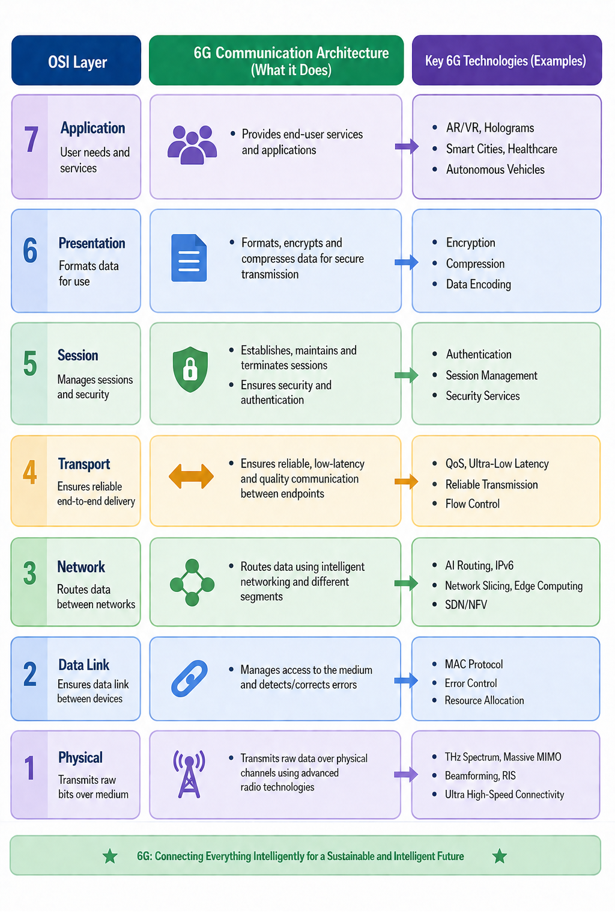

Slide 7
MODULE 1
Module 1: Study of the OSI Model and Study of 6G Communication
OSI Model | 6G Communication
7-layer network communication model. | Next-generation wireless technology.
Standardizes data transmission. | Provides ultra-fast, low-latency communication.
Ensures reliable networking. | Uses AI, THz, and Edge Computing.
Used in all computer networks. | Supports IoT, Smart Cities, XR, and autonomous vehicles.

Slide 8
MODULE 2
Model Development
Module 2: Comparison of 6G Architecture with the OSI Model
Compare the 6G communication architecture with the OSI model.
Identify the role of each OSI layer in 6G communication.
Analyze the similarities and differences between both architectures.
Evaluate the advantages and future scope of 6G communication networks.

Slide 9
ADVANTAGES
Ultra-high data transmission speed for faster communication.
Very low latency for real-time applications. AI-based intelligent network management improves efficiency
Enhanced security and reliability for safe data communication.
Supports future technologies such as smart cities, IoE, autonomous vehicles, and holographic communication.

Slide 10
APPLICATION
Smart Cities – Supports intelligent traffic and public services.
Autonomous Vehicles – Enables real-time communication for self-driving cars.
Healthcare – Supports remote surgery and telemedicine.
Internet of Everything (IoE) – Connects smart devices, sensors, and machines.
Industrial Automation – Improves smart factories and robotics with high-speed connectivity.

Slide 11
Improve AI-based network automation for smarter communication. Increase network speed and capacity using advanced 6G technologies. Enhance security and privacy with next-generation encryption. Expand support for IoE and smart devices across various industries. Enable advanced applications such as holographic communication and digital twins.
FUTURE ENHANCEMENT

Slide 12
CONCLUSION
6G is the future of wireless communication with high speed and low latency.
The OSI model provides a standard framework for network communication.
Comparing 6G and the OSI model helps understand modern networking concepts.
AI, THz communication, and Edge Computing make 6G more intelligent and efficient.
6G will enable faster, smarter, and more reliable communication networks in the future.

Slide 13
Thank You

